Slide 1
An organisation called X Education offers online training for business professionals. The company lists its courses on a number of well-known websites, including Google.The most promising leads that can become paying clients should be chosen by X Education.Even while the business generates a large number of leads, only a small percentage of those leads end up becoming paying customers. Numerous channels, including email, website adverts, Google searches, etc., are used to generate leads.By engaging leads who are known to be interested in taking the course, the organisation has experienced a 30% conversion rate for the entire process of converting leads into clients. Implementing lead-generating qualities is ineffective at assisting conversions.
Dhananjaya Dutt Mishra

Slide 2
Objectives of the Case Study
This case study has a lot of objectives.
Create a logistic regression model to provide each lead a lead score between 0 and 100 that the business may use to target potential prospects.
In contrast, a lower number would indicate that the lead is chilly and unlikely to convert, while a higher score would indicate that the lead is hot and most likely to convert.
You will also need to deal with some additional issues that the firm has raised and that your model should be prepared to address if the company's requirements change in the future.

Slide 3
Approach
Source the data For analysis
Reading & Understanding the data
Data Cleaning
EDA
Feature scaling
Splitting the data into test & train dataset
Prepare the data for modelling
Model building
Model evaluation-specificity & sensitivity or precision recall
Making predictions on the test set

Slide 4
Data Sourcing, Cleaning & PreparationRead
the data from CSV File
Outlier treatment
Data cleaning -Handling Null Values & removing higher Null values data
Removing Redundant columns in the data
Imputing Null Values
Exploratory data analysis-approx.
Conversion Rate is 38%
Feature standardization

Slide 5
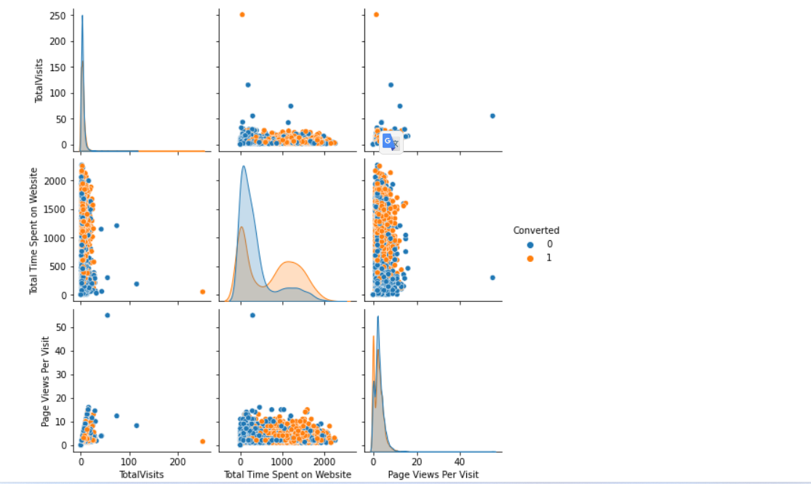
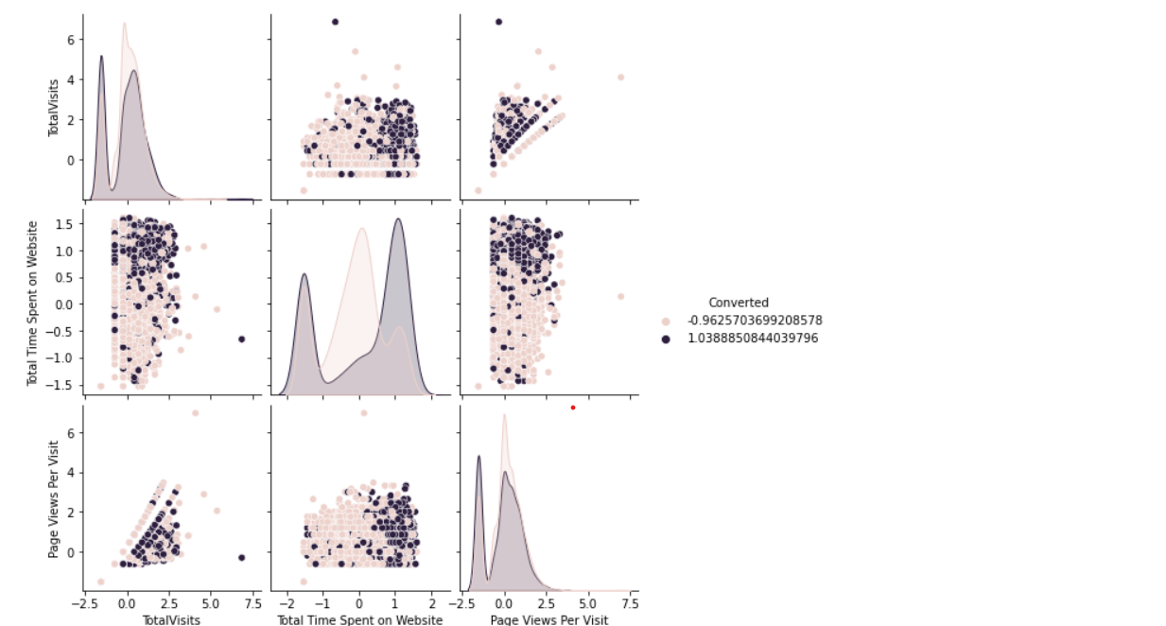
Get the data ready for modelling.
Using Dummy Variables to Get more statistical insight

Slide 6
Model Building
Splitting into train and test set
Scale variables in train set
Build the first model
Use RFE to eliminate less relevant variables
Build the next model
Eliminate variables based on high p-values
Check VIF value for all the existing columns
Predict using train set
Evaluate accuracy and other metric
Predict using test set
Precision and recall analysis on test predictions

Slide 7
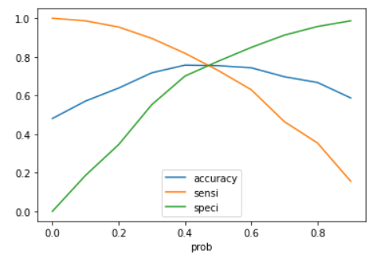
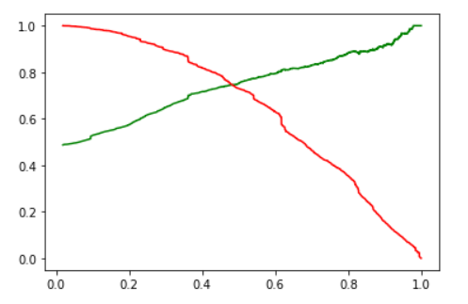
Model Evaluation(Training)
Accuracy , Sensitivity and Specificity
75.9% Accuracy
79.7% Sensitivity
68.9% Specificity
PRECISION AND RECALL
73.0% Precision
79.1% Recall

Slide 8
Model Evaluation(Testing)
PRECISION AND RECALL
71.2% Precision
78.7% Recall

Slide 9
Eda
Many leads are generated in the first stage (top), but few of them turn into paying clients in the second stage. To increase lead conversion, you must properly nurture the potential leads during the middle stage (e.g., by educating the leads about the product and maintaining ongoing communication). Sort out the top prospects first from your generated leads. The factors that have the biggest impact on the likelihood that a lead will be converted are "Total Visits," "Total Time Spent on Website," and "Page Views Per Visit."
We need you need to keep a list of leads close to hand so you can let them know about new programmes, services, job openings, and upcoming higher education. Keep a close eye on each lead so you can customise the information you provide to them. Carefully present career opportunities, information, or training programmes that best suit the leads' interests. A good strategy for identifying each lead's demands can help you convert leads into customers.
Pay attention to leads that have been converted. Engage leads in question-and-answer sessions to gather the pertinent data you require about them. To find out if the leads want to enrol in online courses, make more enquiries and appointments with them.

